Slide 1

College of Computing and Informatics Department of Software and Information Systems
Hyperledger Fabric
Advisor: Dr. Yongge Wang
Ph.D. Student: Ahmed Al Salih

Slide 2
Agenda
Hyperledger
Hyperledger Fabric
Permissionless Vs Permissioned blockchains
Fabric component architecture
Fabric ordering service RAFT
Distributed System Communicate
BFT
PBFT
SMAT_BFT
DLS
BDLS
Contributions

Slide 3
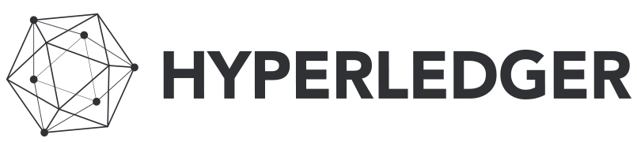
Hyperledger Project is an open-source collaborative effort created to advance cross-industry Blockchain technologies.
It is a project under the LINUX Foundation, Hyperledger is not a single project but a collection of projects under Hyperledger umbrella
Notes:
Hyperledger Project is an open-source collaborative effort created to advance cross-industry Blockchain technologies.
It is a project under the LINUX Foundation, Hyperledger is not a single project but a collection of projects under Hyperledger umbrella, there two type of projects:

Slide 4
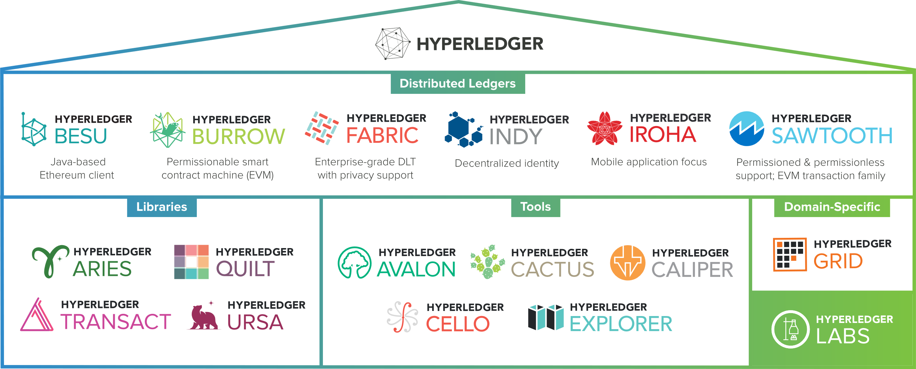
Notes:
Hyperledger Project is an open-source collaborative effort created to advance cross-industry Blockchain technologies.
It is a project under the LINUX Foundation, Hyperledger is not a single project but a collection of projects under Hyperledger umbrella, there two type of projects:

Slide 5
Notes:
1st one is the frameworks these are the distributed ledger technology frameworks. and the 2nd one is the tools and libraries.

Slide 6
Notes:
Hyperledger Fabric is a distributed ledger technology framework.
And there are tools

Slide 7

What is Hyperledger Fabric?
Hyperledger Fabric, an open source project from the Linux Foundation, is the modular blockchain framework and de facto standard for enterprise blockchain platforms. Intended as a foundation for developing enterprise-grade applications and industry solutions, the open, modular architecture uses plug-and-play components to accommodate a wide range of use cases. With more than 120,000 contributing organizations and more than 15,000 engineer contributors working together, Hyperledger Fabric offers a unique approach to consensus that enables performance at scale while also preserving the data privacy enterprises demand.
Notes:
https://www.ibm.com/downloads/cas/0XMOQJNP

Slide 8
How Hyperledger Fabric works
Hyperledger Fabric is an open, proven, enterprise-grade, distributed ledger platform. It has advanced privacy controls so only the data you want shared gets shared among the “permissioned” (known) network participants. Smart contracts document the business processes you want to automate with self-executing terms between the parties written into lines of code. The code and the agreements contained therein exist across the distributed, decentralized blockchain network. Transactions are trackable and irreversible, creating trust between organizations. This enables businesses to make more informed decisions quicker — saving time, reducing costs, and reducing risks.

Slide 9




Benefits of Hyperledger Fabric
Permissioned network
Establish decentralized trust in a network of known participants rather than an open network of anonymous participants.
Confidential transactions
Expose only the data you want to share to the parties you want to share it with.
Pluggable architecture
Tailor the blockchain to industry needs with a pluggable architecture rather than a one-size-fits-all approach.
Easy to get started
Program smart contracts in the languages your team works in today, instead of learning custom languages and architectures.
Notes:
What is hyperledger fabric? | IBM

Slide 10
A Distributed Ledger Technology (DLT)
framework for building Business Blockchain
Applications.
Notes:
The keyword here is Business

Slide 11
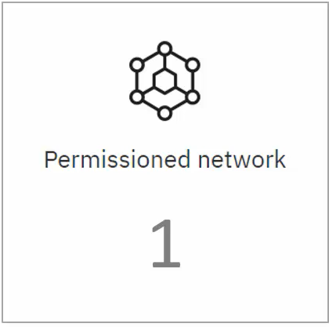
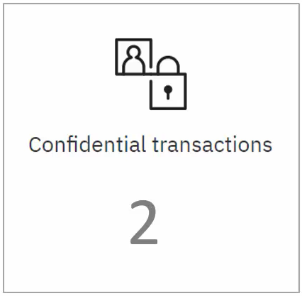
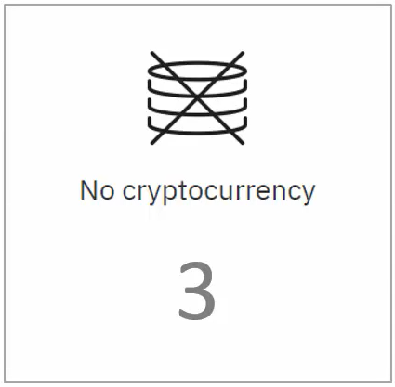
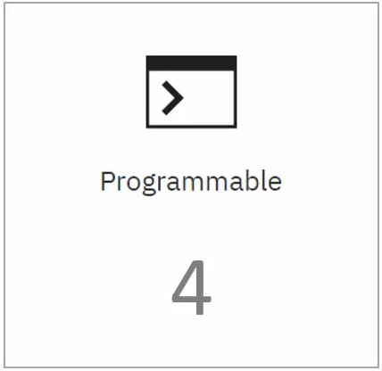
Distributed Ledger Technology for the Business
Notes:
There are four aspects of Hyperledger Fabric distributed ledger technology that makes it suitable for implementing blockchain application for business:
1-permission network
2- confidentiality of the transaction,
3- No need for cryptocurrency for transaction
4- and Programmability.

Slide 12
Distributed Ledger Technology for the Business
Member identities are known
Participants have role-based access
Notes:
In the case of public blockchain network, the participants don’t have to reveal the identity.
They can just download a software and start transacting on the public network.
In the case of a business application, anonymity is not the way things works. * Members of the business blockchain network would always be known entities, and * the participants will be able to take actions based on the Rules…
Hyperledger Fabric is a permissioned network in *which identities are managed and *the roles are assigned

Slide 13
Distributed Ledger Technology for the Business
Not all transactions should be visible to all
Member can transact privately
Notes:
In the case of the public blockchain network, all transaction are visible to everyone.
In the case of a business blockchain network, it not be a desirable thing.
* Most of the time business want to keep their transactions confidential and visible only to the counterparty.
* Hyperledger Fabric allows the members to transact privately.
That means their transactions are visible only to the counter parties and are not visible to the other members on the network.

Slide 14
Distributed Ledger Technology for the Business
No incentivization needed
No crypto tokens needed for transactions
Notes:
In case of public blockchain network, transactions are validated by the members of the network in return of crypto tokens, and that is an incentive which keeps the public networks going.
In the case of a business blockchain network, cryptocurrency or crypto token *based incentivization is not needed. Also, there is no need for *crypto tokens to be given out as a fee for the execution of the
transactions.
Hyperledger Fabric does not have the concept of cryptocurrency

Slide 15
Distributed Ledger Technology for the Business
Smart Contracts
Business Logic Implementation
Notes:
HLF supports *Smart Contracts or ‘chain code’ the chain code encapsulates the *business logic for the implementation of the business blockchain application.

Slide 16


Hyperledger Architecture Component
All Blockchain technologies have the concept of nodes
Nodes connected to other nodes to form the Blockchain network
All Nodes are Equal
ETHEREUM
Notes:
*In public blockchain network such Ethereum and Bitcoin all node are equal But in Hyperledger Fabric the Nodes may not be equal.

Slide 17
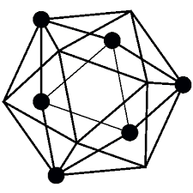

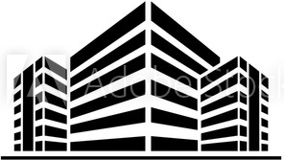



Hyperledger Architecture Component
Members = Legally separate entities
Distributed Ledger(s)
Node
C
Node
Node
Node
Node
A
Node
Node
Node
Node
B
Node
Node
Node
Notes:
In Hyperledger Fabric Distribution Ledger Technology of Blockchain Technology.
*A Concept of Members. Members are legally separate entities * that joint the blockchain network to transact. * These members share one or more distributed ledger * and each of these members host nodes. These node are used for submitting the transactions and for managing the state of the ledger within the organization.

Slide 18



Hyperledger Architecture Component
App
Node
Node
Node
Node
Node
Node
Node
Notes:
Nodes referred to the communication entities of the blockchain.
Each node is assigned an * identity by way of certificates.
Even the users in the blockchain ecosystem * built on Hyperledger Fabric are assigned a certificate

Slide 19
Hyperledger Architecture Component
Assets
Assets
Assets
Ledger
Notes:
Ledgers are used to manage the state of the assets.
These assets in the Hyperledger Fabric Network may represent anything in the real world, such as bonds, loans, title to a house or it can be anything that can be represented digitally.

Slide 20

Hyperledger Architecture Component
Assets
Assets
Assets
Chain code
Manages Asset State
Node
Ledger
Node
Transactions
Node
Node
Channels
Notes:
Nodes initiate the transactions which lead to the execution of the chain code and transaction are recorded in the ledger in the order they received.
These chain code executions also lead to the change of the state of the assets.
There is one ledger per Channel.
So Channels are available by which transaction privacy is achieved in the Hyperledger Fabric network.

Slide 21
Hyperledger Architecture Component
Assets
Assets
Assets
Chain code
Manages Asset State
Node
Ledger
Node
Transactions
Node
Node
Channels
Membership Service Providers (MSP) | Certification Authority (CA)
Notes:
As I mentioned earlier, all of the nodes and users in the Hyperledger Fabric network are assigned an identity, and that is done by way of the Membership Service Providers (MSP) & Certification authority.

Slide 22
Hyperledger Architecture Component
Assets
Assets
Assets
Chain code
Manages Asset State
Orderers
Node
Ledger
Node
Transactions
Node
Peers
Node
Channels
Client
Membership Service Providers (MSP) | Certification Authority (CA)
Notes:
There are 3 types of nodes in the Hyperledger Fabric network: Orderer nodes, Peer nodes & Client nodes

Slide 23

Hyperledger Architecture Component
Node
Orderers
Communication channel of Fabric
Peers
Leader peer
Anchor peer
Only nodes known outside the organization
Client
Use SDK for the user's endpoints
Notes:
Peers can take 3 rolls, by tag, Leader peer, Anchor peer, and the node without tag is a regular node

Slide 24
Hyperledger Architecture Component
Orderers
Communication channel of Fabric
Ordering Service
Responsible for consistent ledger state across the network
Consensus mechanism
Ensures order of transactions
Creates the blocks & guarantees atomic delivery
Notes:
Provide the Communication channel of the network.
A.K.A Ordering Service.
The primary responsibility of the orderer node is to ensure a consistent state of the ledger across the blockchain network.
They provide a Consensus mechanism, and make sure the order of the transactions is maintained.
Orderer creates the blocks and guarantees atomic delivery of these blocks to the peer nodes in the network.

Slide 25
Hyperledger Architecture Component
Notes:
Sample overview of all HFL Components

Slide 26

Hyperledger Architecture Component
Orderers
Implemented with Message Oriented Middleware
The Raft Consensus Algorithm
Diego Ongaro and John Ousterhout, Stanford University (2014) “In Search of an Understandable Consensus Algorithm”
Managing a replicated log.
Crash fault-tolerance (CFT)
Quorum = 1/2N
It produces a result equivalent to (multi-)Paxos
Raft is easier for students to learn than Paxos.
Leslie Lamport “The part-time parliament” (1989)
“Paxos made simple” (2001)
RAFT & Paxos are non-Byzantine model
Notes:
CFT process as either working or crashed — 0 or 1. The processes can’t act maliciously and lie.
a distributed system can be built where a simple majority is enough to reach a consensus.
A quorum is the minimum number of votes that a distributed transaction has to obtain in order to be allowed to perform an operation in a distributed system.
Vs-Reduce the number of states that must be considered.
was Greek to many readers

Slide 27
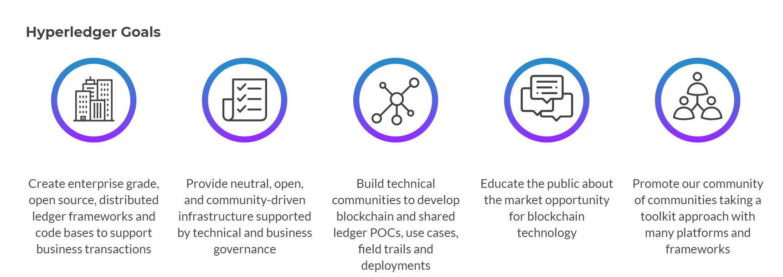

Slide 28
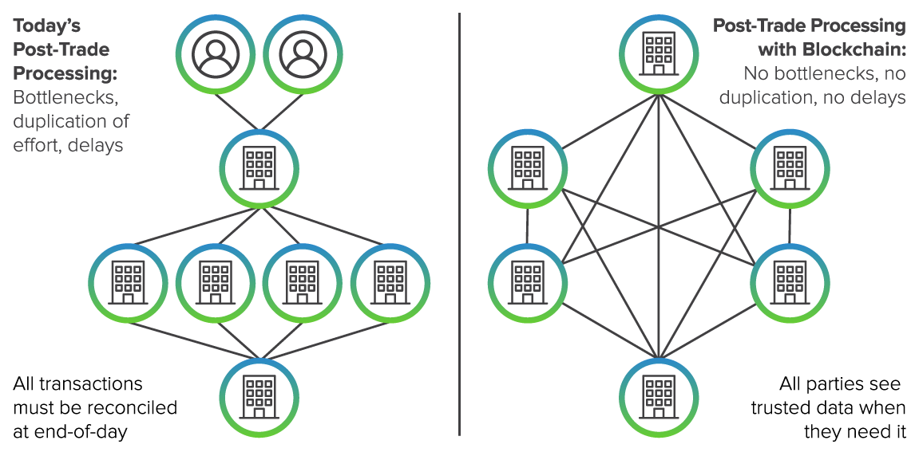
Financial Services
Notes:
Financial Services
Several projects from Hyperledger provide features and functions that can help build effective blockchain solutions for post-trade processing. The channels supported by Hyperledger Fabric can be deployed as fully disjoint networks with separate endorser sets and ordering nodes to provide privacy and confidentiality. Restricting data replication only to permissioned parties delivers the benefits of the blockchain for data integrity and non-repudiation of transactions, without compromising data security. Reporting requirements—both internal and external—can be satisfied by including a regulatory agency and other oversight entities as members of the channel. Network segmentation enabled by Fabric’s channels can support multiple jurisdictions and regulatory regimes.

Slide 29
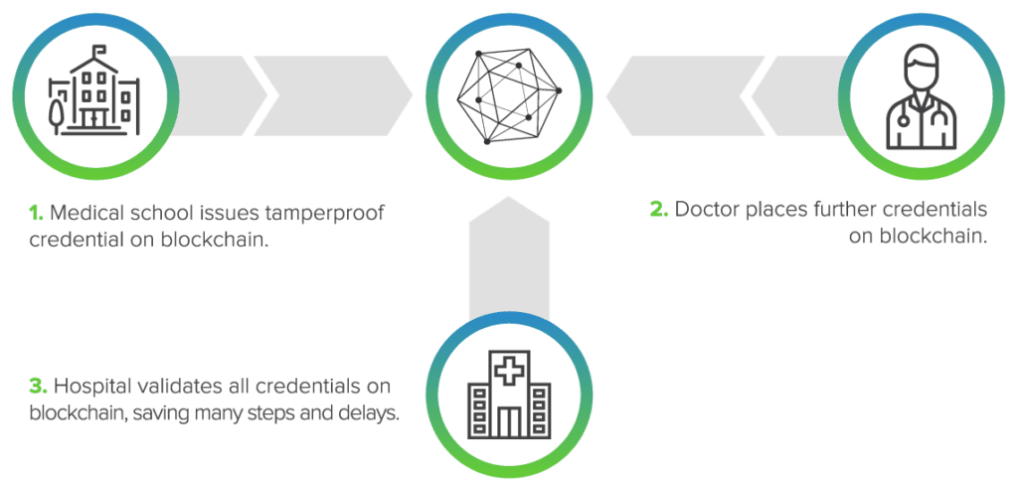
Healthcare
Notes:
Healthcare
Blockchain technologies promise to reduce one of the great annoyances of modern medical practice: “credentialing. Hospitals use the credentialing process to make sure that its physicians are competent and trustworthy. In a sense, credentialing is the hospital’s way of performing “due diligence’’ on a physician.

Slide 30
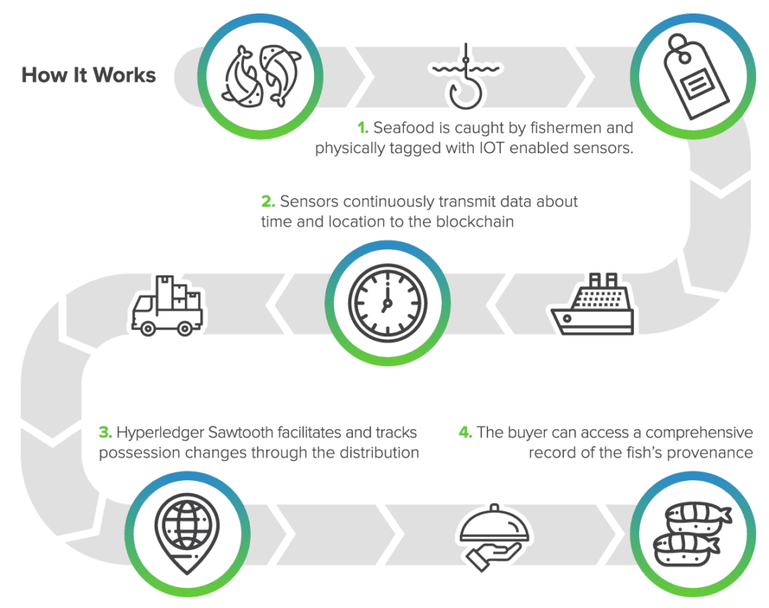
Supply chain
Notes:
Supply chain
Supply chain provides a natural set of use cases for blockchain. It is multi-party. Because there are so many transactions between parties (supplier, logistics, wholesale, retail) and because the various parties maintain independent views of their transaction history there are often issues requiring dispute resolution. Because a supply chain can be very fragmented, it can be difficult to track the provenance and/or location of materials in the supply chain. There are also issues of fraud and theft of material in a supply chain. Yet, by sharing information securely and reducing risk of tampering, the participants in a supply chain blockchain powered network can reap significant rewards in terms of more efficient and accurate transaction processing.

Slide 31
Thanks
Q/A ?

